Slide 1

TECHNICAL SEMINAR ON NEURALINK
Presented By, Under the guidance of,
MANOJ BABU GR
USN:1EP18CS054 Prof. MANIMEGALAI
SEM:8th Semester Department of CSE,EPCET
SEC:’A’ ,
Academic year:2021-2022.

Slide 2
INTRODUCTION
As the days are passing by, we come across new and latest inventions which use Artificial Intelligence to ease our usage of the devices.
This sudden surge in the usage of AI has increased insecurity among humans that it can leave us of no use.
This increased insecurity led people to think what can be done to make our future secure among the robots and artificial intelligence. And out came the solution, mix both the intelligences and achieve a symbiosis between human and AI.
Neuralink is a Brain Machine Interface(BMI). Neuralink as the name suggests creates a link between the Neurons inside our brain and a machine (smartphones or computers).

Slide 3
Concept Used
Brain Machine Interface(BMI):
BMI or B2M is an interface through which we can connect ourselves to any machine which is capable of reading the inputs from our brain.
Brain Machine interface holds the power to help people with a wide range of clinical disorders such as dis-functional sensory and motor functions.

Slide 4
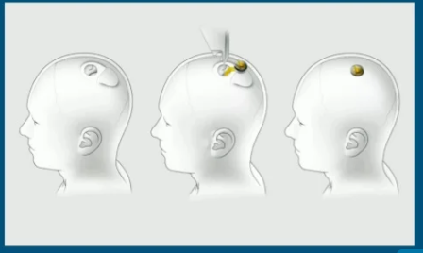
What is Neuralink?
Neuralink is a device specifically, a BMI, That will surgically be implanted into your brain and with it, you will be able to communicate with machines and even control them.

Slide 5
Why Neuralink:
Helps people with spinal cord injury by giving them ability to control computers and machines.
Restoring Motor and sensory functions and the treatment of neurological disorders.
Preserve and enhance your own brain
Security will be built into every layer of the product, using strong cryptography, defensive engineering, and extensive security auditing.
You will be able to communicate with machines and control them

Slide 6
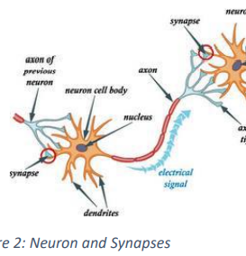
Natural Neural Network
How our brain works is quite interesting. Neurons are like the transport system for our thoughts and actions. Everything we feel, see, sense, touch, taste and think goes through Neurons for further processing. There is an estimate of 100 billion neurons in a human brain which govern the working of the brain.

Slide 7
How Neuralink will use neurons?
Neuralink will setup electrodes which will read those impulses, amplify them and send them to a machine which will then work accordingly. These electrodes support writing also which can help in treatment of brainly disorders.

Slide 8
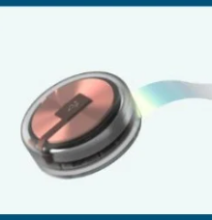
Neural Lace
Is an ultra-thin mesh which will be implanted inside the skull and will form a body of electrodes which will be able to monitor the function of human brain. The ultra-thin mesh is inserted using a tiny needle which contains rolled up mesh. After the mesh is implanted inside the brain, it integrates itself with the human brain and “creates a perfect symbiosis between human and machine”.

Slide 9
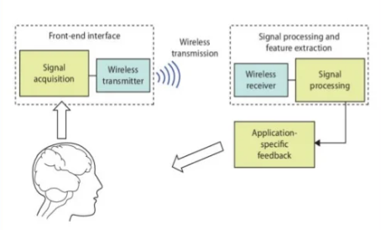
How Does Neuralink Work?
Neuralink will work in five major steps:-
Creation of threads.
Stitching of threads into the tissues.
Reading the signals and cleaning them.
Transmission of signals to amplifier.
Amplification of signals and transmission to the machines.

Slide 10
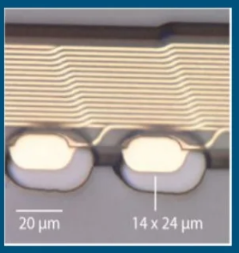
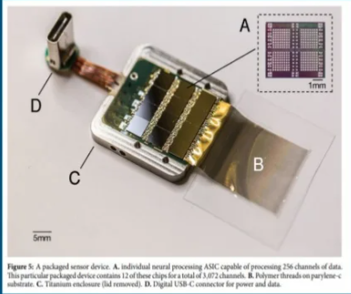
Threads:
“Threads” are the ultra-thin, flexible polymer which will contain the electrodes and will transfer the information and signals to the transmitter. These threads (4-6 µm) are thinner than a human hair (17 µm) and have a length of 20 µm.
Electronics:
The electronics are built around Neuralink’s custom application specific integrated circuit (ASIC), which consists of 256 individually programmable amplifiers (analog pixels), on-chip analog-to-digital converters (ADCs), and peripheral control circuitry for serializing the digitized outputs.

Slide 11
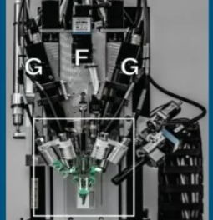
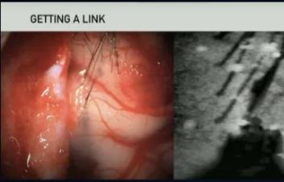
Robot:
The “Robot” is designed with a sole purpose of inserting the threads in least invasive manner.
Neuralink has developed a robotic insertion approach for inserting flexible probes (or threads), allowing fast and reliable insertion of large numbers of threads targeted to avoid vasculature and record from dispersed brain regions.

Slide 12
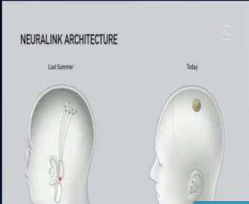
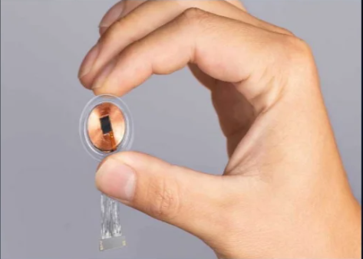
How it looks?

Slide 13
Pros • Alzheimer’s. • Dementia. • Spinal cord injuries. Cons There are no cons as of now but, an electronic device inside a human skull is not been accepted by many communities across some countries.

Slide 14
Applications • For Visual Prosthesis: One of the engineers at Neuralink who works in the visual neuroscience department said that this project has the potential to provide a visual prosthesis for people who have retinal injury or blindness through eye injury. • For Telepathy: Musk called this communication a ‘non-linguistic consent consensual conceptual telepathy’. • An Oscilloscope For Brain: Oscilloscopes provide visual information of printed circuit boards(PCBs). Similarly, the Neuralink device can shed light on many functions of the brain. • Nostalgia On Demand: Memories fade. They get replaced, edited through narratives. As years pile up, the original version is no longer there. Though this sounds like straight out of the movie Memento, it is unfortunately true.

Slide 15
Current Status
A monkey has been apparently been able to interact with a computer
Musk introduced a video of a pig called Gertrude, who had the chip implanted In the brain for two months
It still needs safety and approvals before it goes on top of humans
There are obvious concerns on placing electronics inside human head and there needs to be studies for long term effect

Slide 16
This technology is very young at this stage and can have a bright future depending upon how well it is being received by the consumers. The vision of this technology can be fulfilled if it works properly without glitching otherwise it can become a disaster which wouldn’t create a great image. For it to work, the technology must become reliable and shouldn’t have a price which could be paid by some affluent persons. Neuralink can be one of the biggest inventions/researches of the century if everything goes right as their mission as well as vision can be felt by most of us. The need of time will only decide.
Future for BMI and Neuralink

Slide 17
CONCLUSION
Neural link has developed advance solutions to existing medical problems
It will surely create a well aligned future
Implantation will be done in less than hour and the patient can be left home the same day
Neuralink is still at a very young age( Version 9)
No current idea on how much brain chips will cost.

Slide 18
References
(PDF) Neuralink- An Elon Musk Start-up Achieve symbiosis with Artificial Intelligence (researchgate.net)

Slide 19
THANK YOU

